Slide 1
Unit II Data Structure

Slide 2
Stack & Queue
Elementary Data Structure

Slide 3
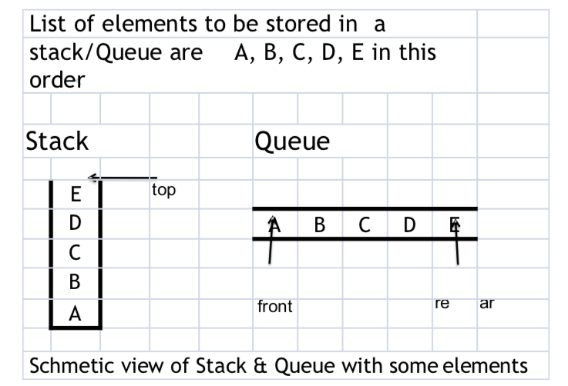
Stack & Queue

Slide 4
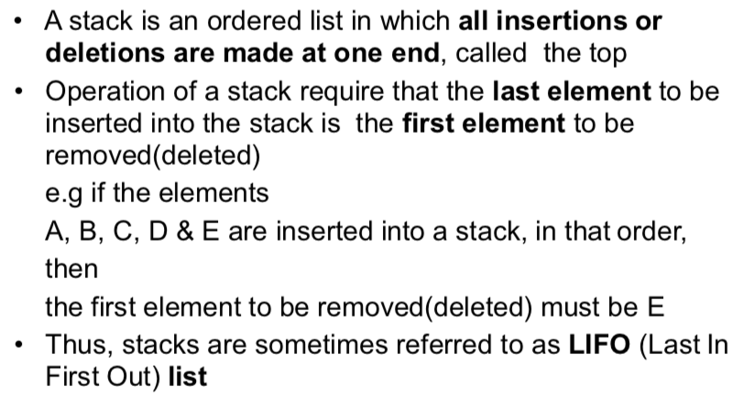
Stack (LIFO List)

Slide 5
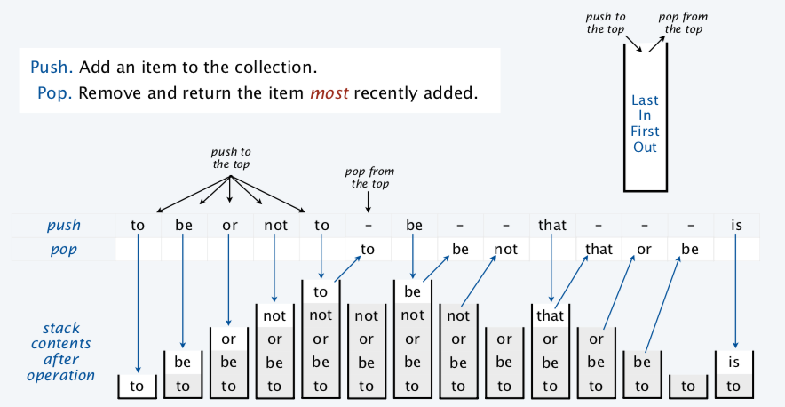
Example of Stack Operation

Slide 6
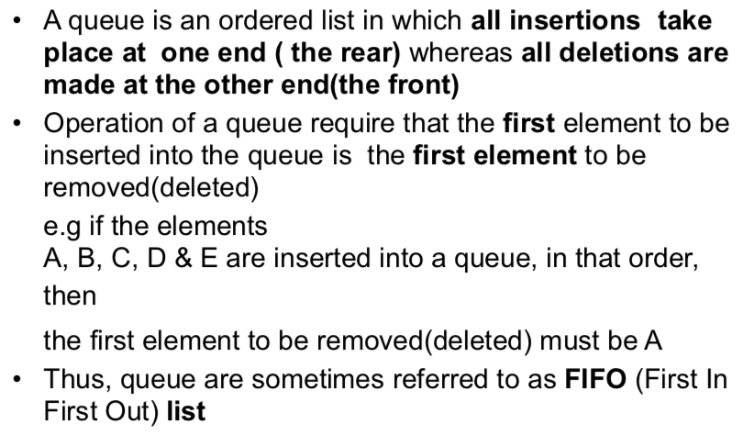
Queue (FIFO List)

Slide 7
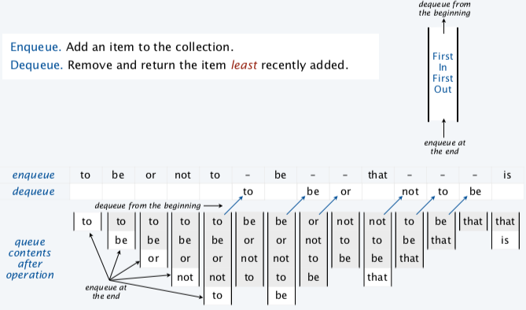
Example of Queue Operation

Slide 8
Stack ADT
push(e): Adds element e to the top of the stack. pop(): Removes and returns the top element from the
stack (or null if the stack is empty).
Additionally, a stack supports the following accessor methods for convenience:
top(): Returns the top element of the stack, without
removing it (or null if the stack is empty).
size(): Returns the number of elements in the stack.
isEmpty(): Returns a boolean indicating whether the stack is e

Slide 9
Stack ADT
The following table shows a series of stack operations and their effects on an initially empty stack S of integers.
Operation | Return Value | Stack Content
S.push(5) | - | [5]
S.push(3) | - | [5, 3]
len(S) | 2 | [5,3]
S.pop() | 3 | [5]
S.is_empty() | False | [5]
S.pop() | 5 | []
S.push(7) | - | [7]
S.push(9) | - | [7,9]
S.top() | 9 | [7,9]
S.push(4) | - | [7,9,4]
len(S) | 3 | [7,9,4]

Slide 10
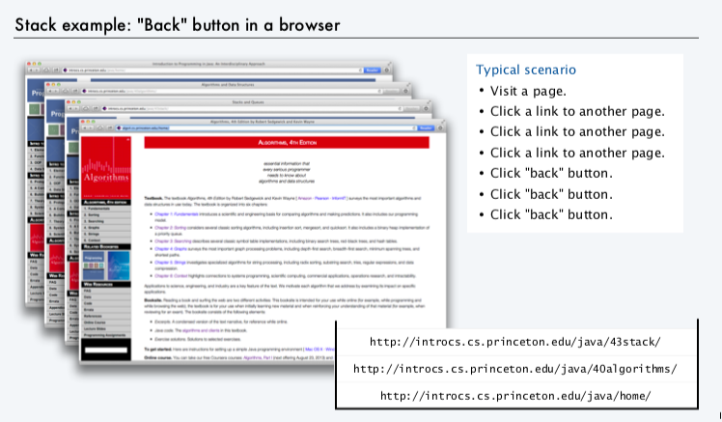
Stack Application

Slide 11
Queue ADT
enqueue(e): Add element e to the back of the Queue Q.
dequeue(): Remove and return the first element from queue Q.
Additional Methods:
first(): Return a reference to the front of the queue Q, without removing it; an error occurs if the queue is empty
is_empty(): Returns true if queue Q does not contain any elements.
len(Q): Return the number of elements in queue Q;

Slide 12
Queue ADT
The following table shows a series of Queue operations and their effects on an initially empty Queue Q of integers.
Operation | Return Value | First ← Q ← last
Q.enqueue(5) | - | [5]
Q.enqueue(3) | - | [5, 3]
len(Q) | 2 | [5,3]
Q.dequeue() | 5 | [3]
Q.is_empty() | False | [3]
Q.dequeue() | 3 | []
Q.is_empty() | True | []
Q.dequeue() | “error” | []
Q.enqueue(7) | - | [7]
Q.enqueue(9) | - | [7,9]
Q.first() | 7 | [7,9]
Q.enqueue(4) | - | [7,9,4]
len(Q) | 3 | [7,9,4]

Slide 13
Stack & Queue
Elementary Data Structure
A simple array-based Stack and Queue Implementation
Implementing Stack and Queue with a Singly Linked List.

